Slide 1


Biometric Phone Security
Ryan Miyahara
CS35L Lab 6
Winter 2018

Slide 2
First, I have to answer Rahul’s question

Slide 3
Article: “Russian experts submit ‘impenetrable’ smartphone protection system”
Expecting a release within the month
Android only
Target audience
Will provide a unique hassle free security measure for your phone.
“95% precision”
Uses data analysis, machine learning, and artificial neural networks

Slide 4
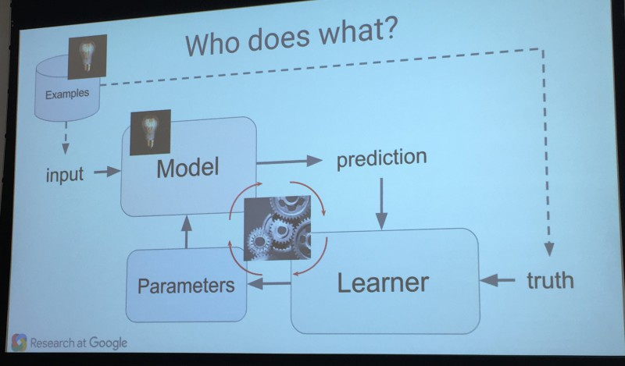
Machine Learning

Slide 5
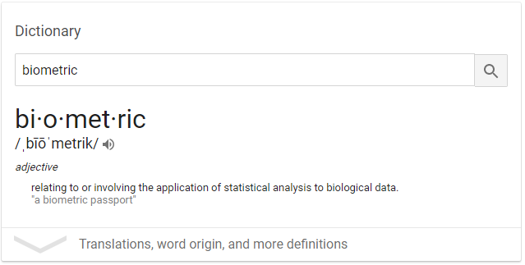
Thanks Google.

Slide 6
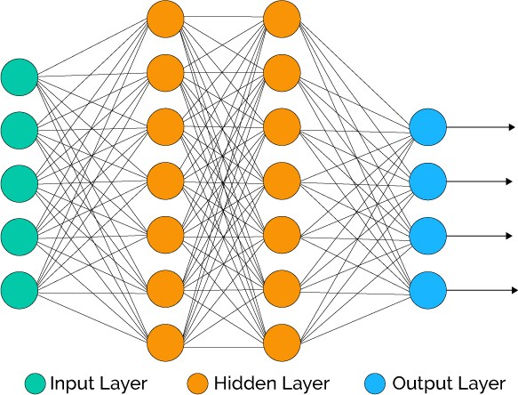
Artificial Neural Networks
Uses previous examples to find correct answers.
Each node has a weight which contributes to its connection
Weights are adjusted during process.
Hidden layers make input into something the rest of the program can use.

Slide 7
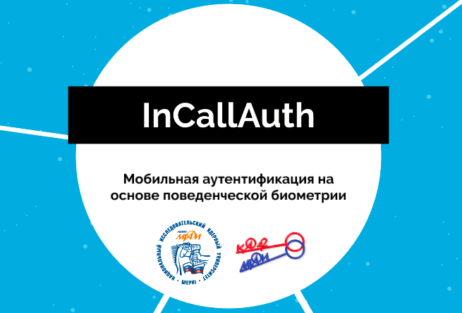
Applications
An app that prevents your phone from being used unless it is picked up by you.
Uses machine learning, with input from your phone’s sensors, to create a model of your gestures.
Made in Russia
Able to read what I could, due to Ashley Miao’s presentation on Tuesday.
If your gesture is unrecognized, it asks for a password.

Slide 8
References
“Researchers develop biometric app for smartphone security.” Phys.org - News and Articles on Science and Technology, phys.org/news/2017-03-biometric-app-smartphone.html.
Eremin, Alexandr. “InCallAuth.” Prezi.com, 11 Nov. 2016, prezi.com/grrtqmczaihj/incallauth.
“Machine Learning: What it is and why it matters.” What it is and why it matters | SAS, www.sas.com/en_us/insights/analytics/machine-learning.html.
“How Machine Learning Works, As Explained By Google.” MarTech Today, 3 May 2017, martechtoday.com/how-machine-learning-works-150366.
XenonStack. “Overview and Applications of Artificial Neural Networks.” Medium, Medium, 17 July 2017, medium.com/@xenonstack/overview-of-artificial-neural-networks-and-its-applications-2525c1addff7.

